Slide 1

AFRICAN CULTURAL IDENTITY AND AFRICAN GLOBAL IMAGE

Slide 2
Euro-centric Views Denigrating Africa
“Always something new out Africa.” Pliny the Elder.

Slide 3
“The Dark Continent” H. M. Stanley

Slide 4
“Africa is no historical part of the world . It has no movement or development to exhibit”. Hegel

Slide 5
“Apart from the relatively late Semitic influence...the civilisations of Africa are the civilisation of the Hamites...The incoming Hamites were pastoral Caucasians – arriving wave after waves – better armed as well as quicker witted than the dark agricultural negroes”. C. G. Seligman in Races of Africa.
(This claim is called the Hamitic Hypothesis),

Slide 6
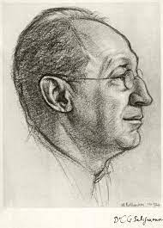
Charles Gabriel Seligman

Slide 7
“Where segregation is compatible with work and duty, commercial firms no less than the government, incur a moral responsibility not to expose their employees to infection which can be avoided …. We have learnt that malarial germs – and at times those of yellow fever also – are present in the blood of most natives, especially native children and their dark huts and insanitary surroundings foster mosquitoes by which these diseases are conveyed…Europeans should not sleep in proximity with the natives in order to avoid infection”. Lord Lugard

Slide 8
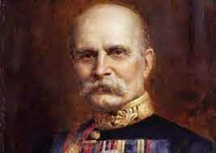
Frederick Lugard

Slide 9
The openings for white labour… are confined to appointments in which the salary permits the individual to live well; not having to stint himself in the necessaries of life. Further, the manual labour which a European has to perform out here should be limited. His exertions should chiefly be confined to superintendence… The manual work I refer to as not being suitable to this climate is that of actual labour, such as is connected with road-making, house-building, etc. All such labour is best left to natives as much as possible. Lord Lugard
(National Archives Ibadan). Colonial Report. Annual -Nigeria. 1899-1900. London: His Majesty Stationery Office, H. M. S O., 25-26.)

Slide 10
“Africa had no history prior to European exploration and colonisation, there is only the history of Europeans in Africa. The rest is darkness”, her past “the unedifying gyrations of barbarous tribes in picturesque but irrelevant corners of the globe”. Trevor Roper

Slide 11
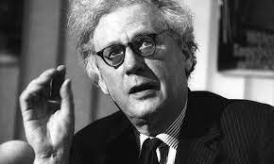
Trevor Roper

Slide 12
“The dealings between tropical Africa and the West must be different. Here in place of the larger unities of Asia was the multi-cellular tissue of tribalism; instead of an ancient civilization [it has] the largest area of primitive poverty enduring into the modern age. Until the very recent penetration by Europe the greatest part of the continent was without the wheel, the plough and the transport animal; almost without stone houses or clothes except for skins: without writing and so without History” –
Margery Perham (Adviser to British colonial govrnment)

Slide 13
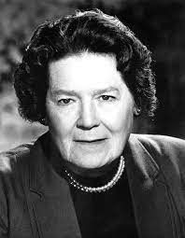
Margery Perham

Slide 14
CONTEMPORARY TIMES (Viral Internet post, purportedly by Donald Trump)
“They are good in nothing else but making noise, dancing, marrying many wives, alcoholism, witchcraft, indulging in sex, pretending in church, jealousy, fighting and complaining of bad leadership; but, yet refuse to take a decisive action and protest to remove the brigands from position of power. Let us all accept the fact that the black man is a symbol of poverty, mental inferiority, laziness...”

Slide 15
Influence from ‘Darwin’s Heresy’ imbeded in his theory of natural selection/ evolution.
"The various races, when carefully compared and measured, differ much from each other – as in the texture of hair, the relative proportions of all parts of the body, the capacity of the lungs, the form and capacity of the skull, and even the convolutions of the brain. But it would be an endless task to specify the numerous points of difference. The races differ also in constitution, in acclimatization and in liability to certain diseases. Their mental characteristics are likewise very distinct; chiefly as it would appear in their emotion, but partly in their intellectual faculties." (The Descent of Man, chapter VII)

Slide 16
IMAGE BATTERING EXPERIENCES IN AFRICA
Racism
Slave trade
Colonialism
Victim of culture capture
Apartheid
Neo-colonialism
Third world rating
Ethnic conflict
Political instability
Corruption
Irregular migration
Consumers rather than producers
IMF and World Bank conditionalities/reliance on foreign Aids
Etc

Slide 17
FACTORS OF A POSITIVE IMAGE IN AFRICA
1. Birth place of Mankind
2. Evidence of political, social and economic culture (material and non-material/ Objective and subjective
3. Emergence of centres of civilisation across Africa
4. Large population and market
5. Varieties of mineral resources
6. Cultural rebirth. Growing popular culture (E.g. Music and fashion)
7. Youthful population
8. African renaissance concept (Cheik Anta Diop of Senegal, Thabo Mbeki of South Africa, Kwame Nkruma of Ghana, Nnamdi Azikiwe and Obafemi Awolowo of Nigeria
9. Decolonising African history. Ibadan school of history, The general History of Africa by UNESCO
10. UNESCO recognised cultural sites
11. Restoration of works of arts stolen from Africa
12. Africa-Diaspora linkages
13 . African Union Charter for African Cultural Renaissance
14. Debate on reparation

Slide 18
RENAISSANCE FOR CHERISHED VALUES and Institution of Developmental Programmes
Restoration of Cherished values
Hospitality
Communalism
Religious tolerance
Artistry
Unparalleled care for aged parents
Extended family relations against individualism of the West
Respect for elders
Moral probity
Developmental programme and economic Planning
Curbing corruption
Economic planning
Harnessing human and mineral resources
Regional integration
Pan-Africanism

Slide 19
MUST READ
AFRICAN UNION CHARTER FOR AFRICAN RENAISSANCE
https://au.int/sites/default/files/treaties/37305-treaty-Charter_for_African_Renissance_ENGLISH_digital_0.pdf

Slide 20
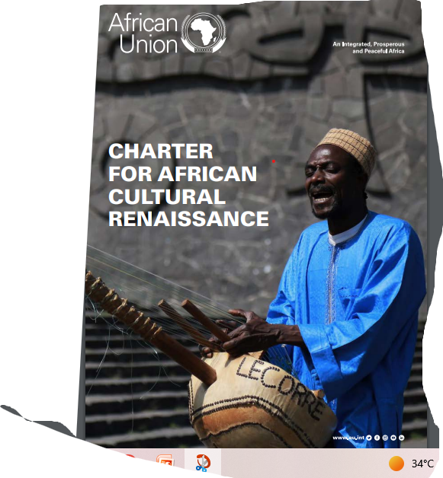

Slide 21
HIGHLIGHTS of the AU CHARTER
Support for culture diversity and right to express them.
Teaching of African cultural values
Recognition and support and patronage of private initiatives
Training and support for the youth and professional artists (Goodluck Jonathan)
Use of African languages
Use of Mass media (Eg www.africagiant.org )
Preservation of artistic goods and cultural heritage
Repatriation of stolen cultural heritage
Intra and inter-African cultural cooperation (Remember FESTAC 77)
Encouraging Advocacy by States, schools, NGOs etc
Creating and supporting appropriate institutions. Eg ministries, commissions , museums, etc

